Slide 1

GRAPH THEORY and its APPLICATIONS
Course Instructor: Dr. Arti Arya
Department of Computer Science & Engineering

Slide 2

GRAPH THEORY, APPLICATIONS AND COMBINATORICS
Planar Graphs
Dr. Arti Arya
Department of Computer Science & Engineering

Slide 3
Graph Theory and its Applications Acknowledgement
The slides are prepared by Dr. Surabhi Narayan and a lot of material is added by Dr. Arti Arya. The sources of the information other than textbook is mentioned wherever used. The material is prepared from various resources like universities from abroad and India and also internet resources.

Slide 4
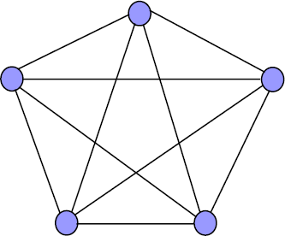
Graph Theory and its Applications Planar Graphs
Planar Graph
A graph G is planar if it can be drawn on a plane surface with no two edges intersecting
G is stbe embedded in the plane.
A graph that can’t be drawn on a plane surface without a crossover between the edges is called a non-planar graph.
K3
K4
K5

Slide 5






Graph Theory and its Applications Planar Graphs
Homeomorphic Graph
Two graphs G1 and G2 are stb homeomorphic if one of these can be obtained from the other by the process of
(a) insertion of new vertices (of degree 2) into its edges
(b) merging of adjacent edges.
A
D
B
C

Slide 6
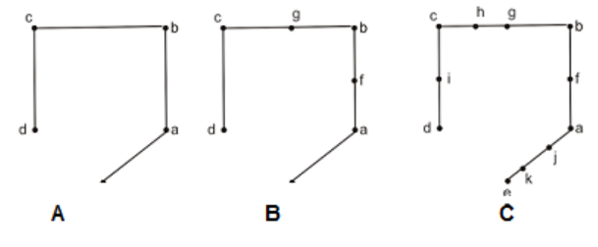
Graph Theory and its Applications Planar Graphs
Homeomorphic Graph
Two graphs G1 and G2 are stb homeomorphic if one of these can be obtained from the other by the process of
(a) insertion of new vertices of degree two into its edges
(b) merging of adjacent edges.
A and B are homeomorphic
A and C are homeomorphic
B and C are homeomorphic
But A & B or A & C are not isomorphic or even B and C are also not isomorphic.

Slide 7
Graph Theory, Applications and Combinatorics Applications of Planar Graphs
Circuit Layout Design: Planar graphs are commonly used in the design and optimization of electronic circuits. The arrangement of components and connections in a circuit can be modeled as a planar graph. Algorithms that work with planar graphs can help in minimizing wire crossovers, reducing signal interference, and improving circuit performance.
2. Geographical Information Systems (GIS): Planar graphs are used in GIS applications to represent and analyze geographic data. Road networks, utility networks, and transportation systems can be modeled as planar graphs. AI algorithms can be applied to planar graphs to optimize route planning, network connectivity, and resource allocation.
3. VLSI Design: Very Large Scale Integration (VLSI) design involves creating integrated circuits with a large number of components. Planar graphs are used to model the layout of these components, including their connections and placements. AI techniques can aid in optimizing the layout for better performance, power efficiency, and manufacturability.
4. Map Labeling and Graph Drawing: In cartography, planar graphs are used to solve map labeling problems where labels need to be placed on a map without overlapping. Graph drawing algorithms that work with planar graphs can help generate visually appealing and informative maps.

Slide 8
Graph Theory, Applications and Combinatorics Applications of Planar Graphs
5. Scheduling and Timetabling: Planar graphs can be used to model scheduling and timetabling problems where events, tasks, or resources need to be allocated efficiently. AI algorithms can optimize schedules to minimize conflicts, delays, or resource utilization.
6. Constraint Satisfaction Problems: Planar graphs can be used as a basis for solving constraint satisfaction problems (CSPs) in AI. Many real-world problems can be formulated as CSPs, and planar graph-based techniques can help in solving them efficiently.
7. Network Design and Communication: Planar graphs can represent communication networks, such as wireless sensor networks or communication channels. AI algorithms can optimize network design, routing, and communication protocols to ensure efficient and reliable data transmission.
8. Game AI and Pathfinding: In video games, planar graphs are used for pathfinding algorithms that guide characters or agents through a game environment. AI algorithms can efficiently navigate the graph to find optimal or near-optimal paths.
These are just a few examples of how planar graphs play a role in AI applications. Their inherent structure and properties make them valuable tools for modeling, analyzing, and optimizing various real-world systems and problems.

Slide 9
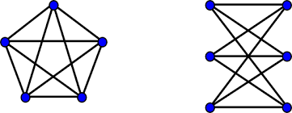
Graph Theory, Applications and Combinatorics Planar Graphs
Kuratowski’s theorem
A necessary and sufficient condition for a graph G to be planar is that G does not contain K₅ or K_{3,3} as a subgraph or any subgraph homeomorphic to either of these.

Slide 10
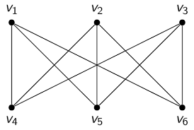
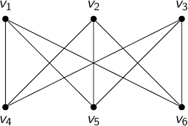
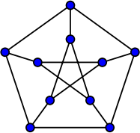




Graph Theory, Applications and Combinatorics Planar Graphs
Show that Petersen graph is a non-planar Graph
V10
V7
V9
V8
V2
V5
V6
V4
V9
V8
V10
V7
V9
V8
V1
V3
V10
V7

Slide 11
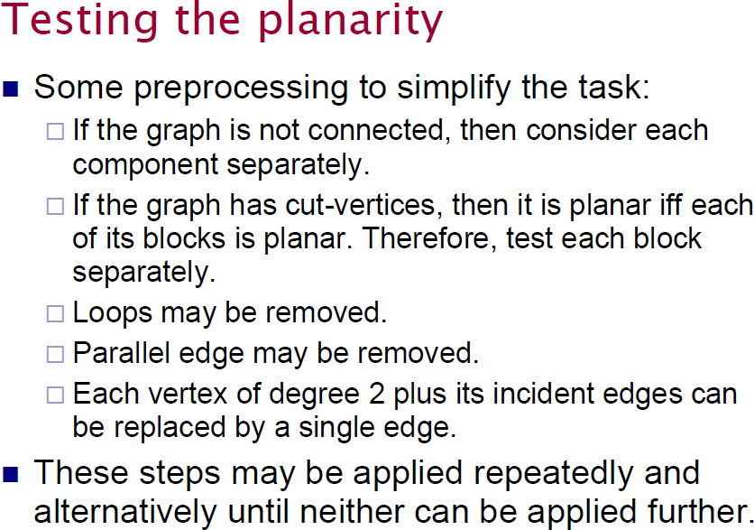
Graph Theory and its Applications Planar Graphs( Elementary reduction Method)

Slide 12
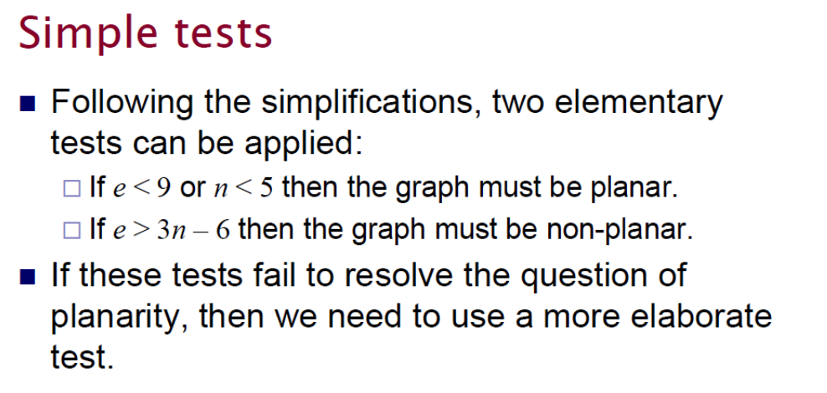
Graph Theory and its Applications Planar Graphs

Slide 13
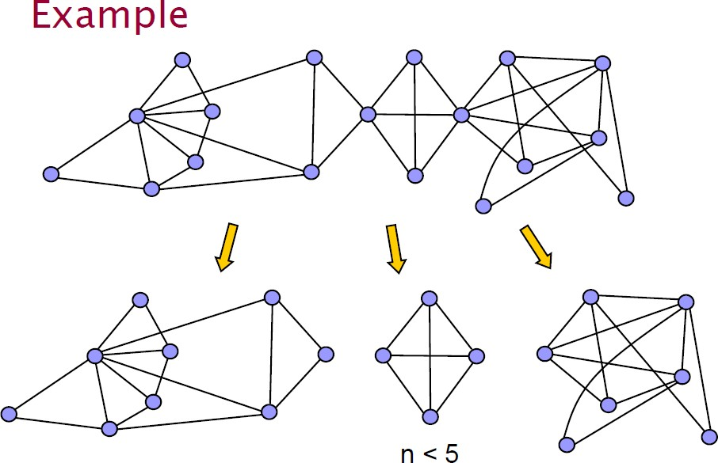
Graph Theory and its Applications Planar Graphs

Slide 14
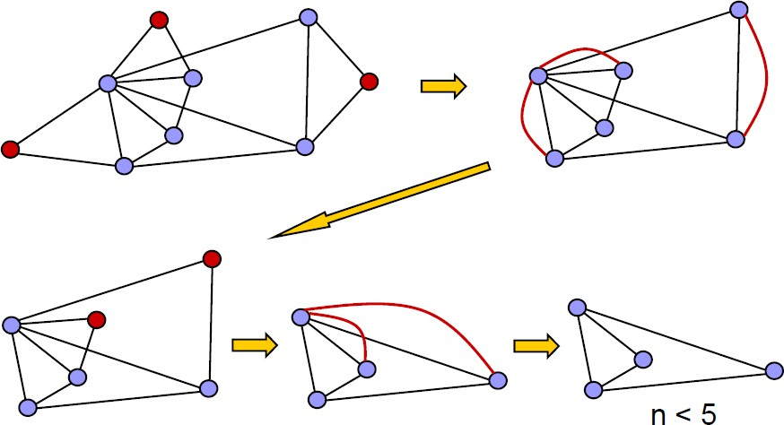
Graph Theory and its Applications Planar Graphs

Slide 15
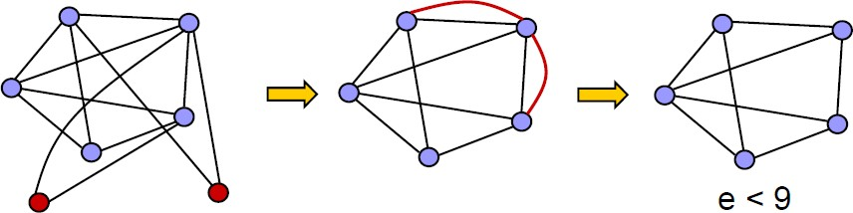
Graph Theory, Applications and Combinatorics Planar Graphs

Slide 16
Graph Theory, Applications and Combinatorics Planar Graphs

Slide 17
Graph Theory, Applications and Combinatorics Planar Graphs
G3
G2
G1

Slide 18
Graph Theory, Applications and Combinatorics Planar Graphs
G3
G2
G1

Slide 19
Graph Theory, Applications and Combinatorics Planar Graphs
G3
G2
G1
G is planar

Slide 20
Graph Theory, Applications and Combinatorics Planar Graphs
Using Kuratowski’s theorem, prove that G is non planar
G
G1
K3,3
G2
G1 is a subgraph of G
G2 is homeomorphic to G1 G2 is isomorphic to K3,3 Hence G is non planar

Slide 21
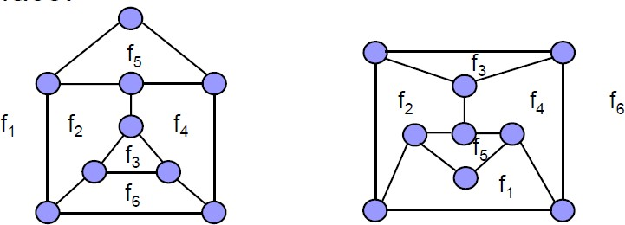
Graph Theory, Applications and Combinatorics Planar Graphs
Faces (regions)
A planar representation of a graph divides the plane into a number of connected regions: faces.
Each face is bounded by edges.
One of the faces encloses the graph: exterior face.

Slide 22
Graph Theory, Applications and Combinatorics Planar Graphs
Euler’s Theorem on Planar Graphs
If a connected planar graph G has ‘n’ vertices, ‘e’ edges and ‘r’ regions then
n – e + r =2
If G= (V,E) is a connected simple graph with |V| = n, |E| = e > 2 and r regions, then e >= 3r/2 and e <= 3n - 6
R4
n = 7
e = 9
r = 4
n – e + r =2 7-9+4=2
R1
R2
R3

Slide 23
Graph Theory, Applications and Combinatorics Planar Graphs
Show that kuratowski’s 1st graph (K5) is nonplanar e=10
n = 5
For planar graph e <= 3n -6
10 <= 9 false hence K5 is nonplanar

Slide 24
Graph Theory, Applications and Combinatorics Planar Graphs
Verify the Euler’s formula for the graph shown below

Slide 25
Graph Theory, Applications and Combinatorics Planar Graphs
A connected planar graph has 9 vertices having degrees, 2,2,2,3,3,3,4,4,5. How many edges and faces(regions)are there?

Slide 26
THANK YOU
Surabhi Narayan
Department of Computer Science &Engineering
surabhinarayan@pes.edu

